Slide 1
Simple Interest – Rearranging Simple Interest Formula

Slide 2
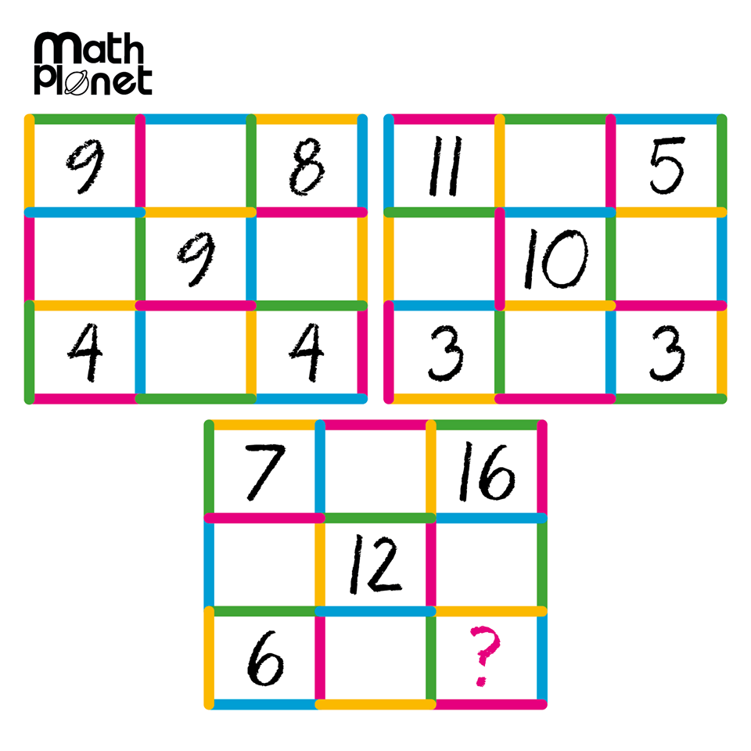
Mental Warm Up
Mental warm up.

Slide 3
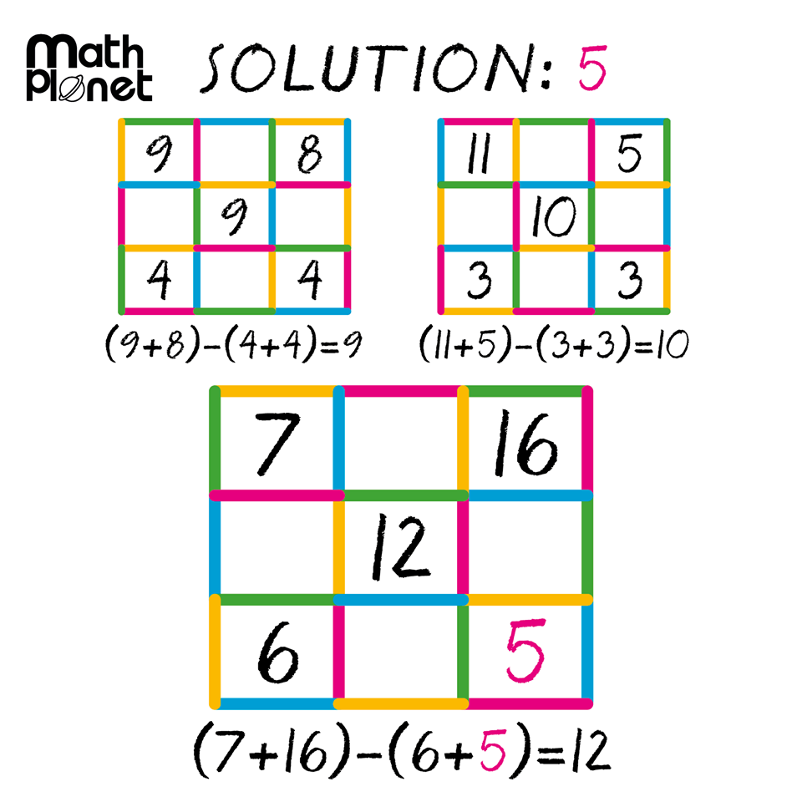

Slide 4
24
7
30
24
7
30
Simple Interest Continued
Date: /2018
EQ – How do you calculate for the other variables in the simple interest formula?
Joe wants to borrow $2000. He will take 2 years to pay the money back, and the bank’s interest rate is 8% (per year).
How much simple interest does he pay?
How much does he pay altogether?
When solving word problems you need to list all your information systematically.
P =
R =
T =

Slide 5
24
7
30
24
7
30
Simple Interest Continued
Date: /2018
EQ – How do you calculate for the other variables in the simple interest formula?
Susie borrows $4500. She expects to pay it off after 3 years. The bank charges 9% interest.
How much interest does Susie pay?
How much does she pay altogether?
When solving word problems you need to list all your information systematically.
P =
R =
T =

Slide 6
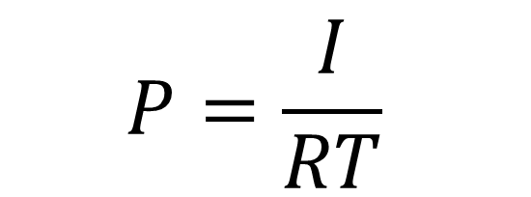
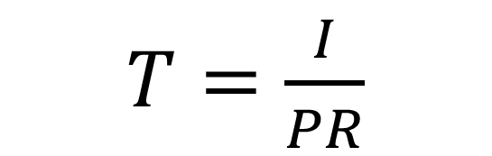
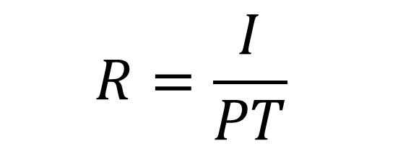
24
7
30
24
7
30
Simple Interest Continued
Date: 03/09/2018
EQ – How do you calculate for the other variables in the simple interest formula?
I = PRT
What was the principal?
$$P=\frac{I}{RT}$$
What was the rate?
$$R=\frac{I}{PT}$$
What was the time?
$T=\frac{I}{PR}$

Slide 7
